Slide 1
Visual Analytics– Role of Interaction
Dr. Ab Mosca (they/them)
Slides based off slides courtesy of Jordan Crouser (https://jcrouser.github.io/)

Slide 2
Plan for Today
Interaction and Analysis
Definition
Interaction with data and problem space
Interaction with visual interfaces
Demo: plotly

Slide 3


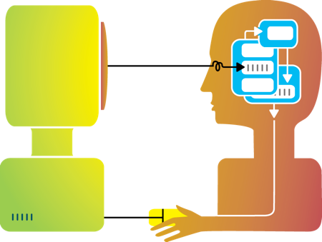
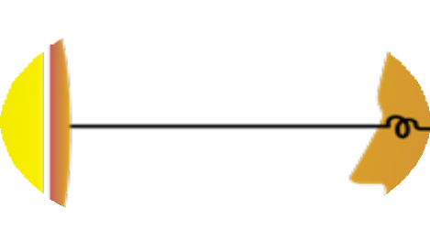
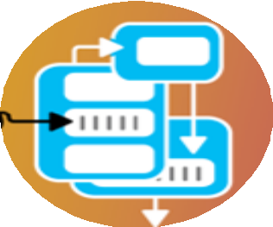




Rewind
Humans and machines have complimentary strengths
Visualization
Perception
and context
Interaction
Computational power
Image credit: Ali Ansari

Slide 4
Methods by which humans create knowledge through the manipulation of an interface
Low level: between human and interface
the set of operations available
the relationship between the human and the visualization
High level: between human and problem space
a cognitive act enabled by the tool
does not need to take place exclusively within them
might be distributed across multiple tools
Interaction (def.)

Slide 5
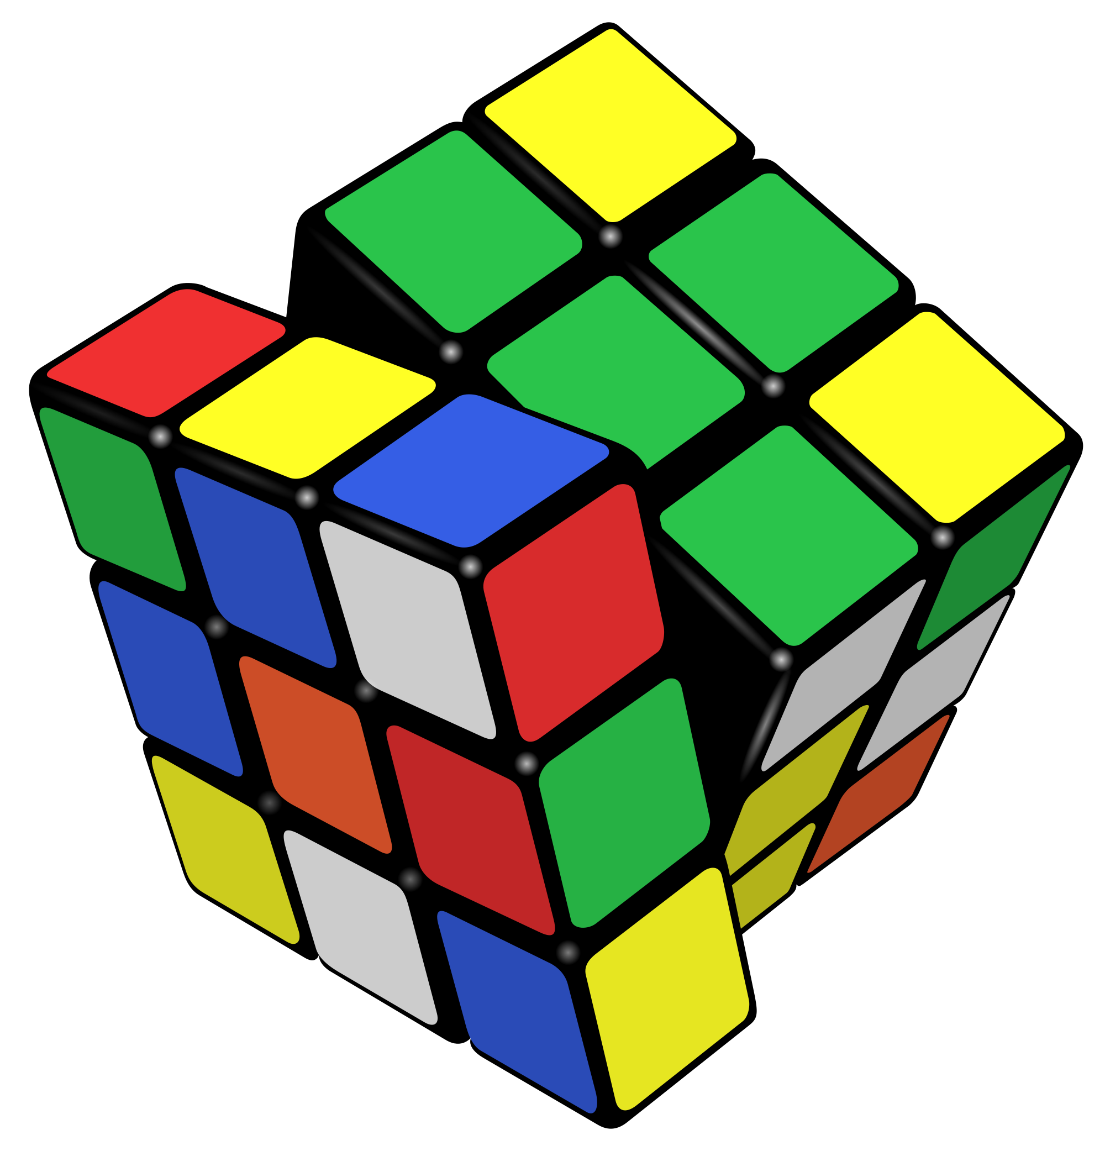
Example: Rubik’s Cube
What low-level interactions can you have?
What high-level interactions can you have?

Slide 6
Part I: High Level
Interaction with
Data / Problem Space

Slide 7
Interaction and analysis
Interaction is the observable result of a cognitive process: “an externalization of thought”
In visualization, there is a growing belief that interaction and analysis are actually the same thing!
Analytic discourse: the idea that knowledge is constructed, tested, refined, and shared through the interactive manipulation of an interface¹
¹Pike, W. A., Stasko, J., Chang, R., & O'Connell, T. A. (2009).
The science of interaction. Information Visualization, 8(4), 263-274.

Slide 8
Interaction happens in the context of a problem or goal-directed activity
This context helps the human identify relevant concepts and link them into appropriate structures
Interaction brings together background contexts and current observations
This is known as “situated cognition”
Interaction as a reasoning aid

Slide 9
Hypothesis: the more ways a user can ‘touch’ their data (by changing their form or exploring them from different perspectives), the more insight will accumulate.
Reality Check

Slide 10

Interaction as Distributed Cognition
Visualization is often used as a tool to “offload” storage or computation from the human’s brain
In order for this to be useful, we have to be able to “reload” parts of the data and operate on it
Internal (in your head) vs.
external (on the screen) representations
Consider the impact of the affordances
of the interface

Slide 11
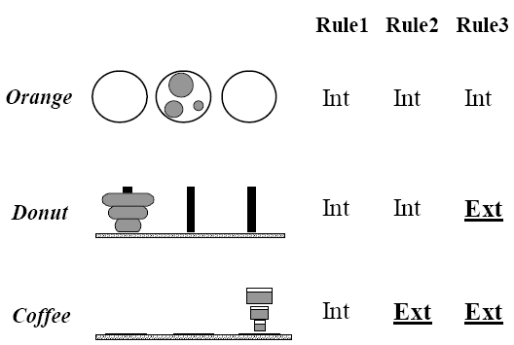
Example: Tower of Hanoi
Only one disk can be transferred at a time.
A disk can only be transferred to a pole on which it will be the largest.
Only the largest disk on a pole can be transferred to another pole.

Slide 12
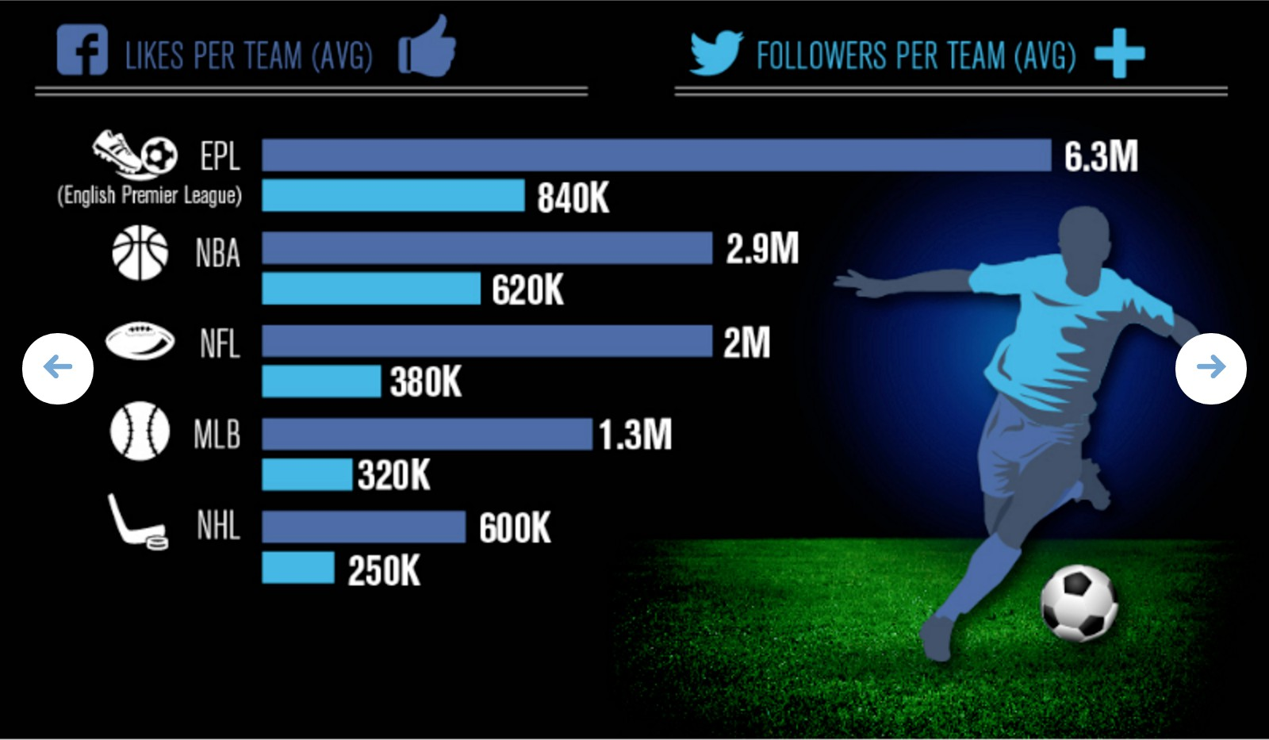
Example
What representations are internal vs. external?

Slide 13
Pragmatic actions move a person and their analysis closer to the desired destination
Epistemic actions enable humans to leverage environmental structures to link internal structures
The purpose of some actions is not for the effect they have on the environment but for the effect they have on the humans
Pragmatic vs. Epistemic Action

Slide 14
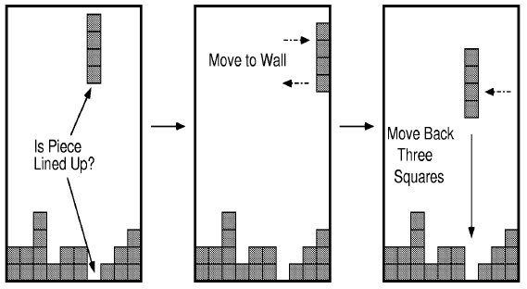
Example: Tetris Behavior

Slide 15
Part II
Interaction with
a Visual Interface

Slide 16
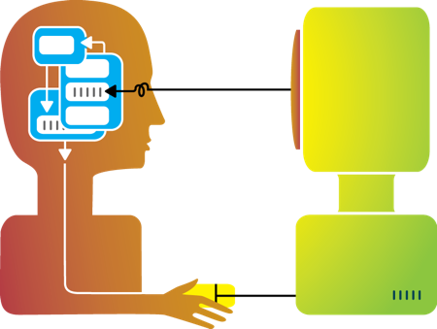
So far…
Visualization

Slide 17
Flashback: interaction as a reasoning aid
Interaction is situated in the context of a problem or goal-directed activity
Question: what kinds of things might someone want to do using a visualization?

Slide 18
Yi, Kang, Stasko and Jacko (2007)
Select: mark something as interesting
Explore: show me something else
Reconfigure: show me a different arrangement
Encode: show me a different representation
Abstract/Elaborate: show me more or less detail
Filter: show me something conditionally
Connect: show me related items
Yi, J. S., ah Kang, Y., Stasko, J. T., & Jacko, J. A. (2007). Toward a deeper understanding of the role of interaction in information visualization. Visualization and Computer Graphics, IEEE Transactions on, 13(6), 1224-1231.

Slide 19
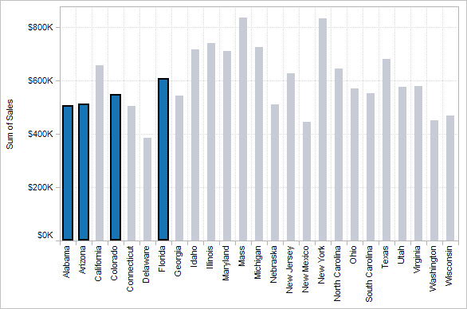
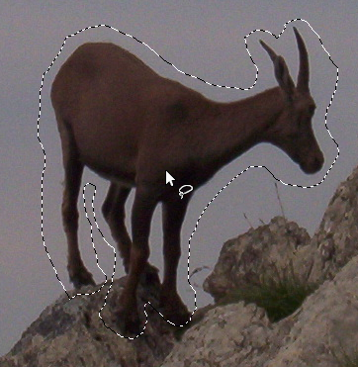

1. Select
Mark something as interesting: direct

Slide 20
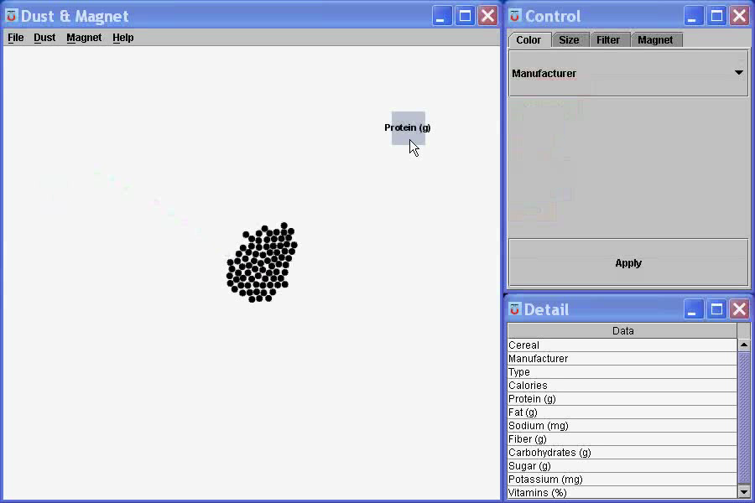
Mark something as interesting: indirect
1. Select
Notes:
What are you selecting? One item at a time?
Selecting of a value?
Selecting of a range?
Selecting of a position on the screen?

Slide 21
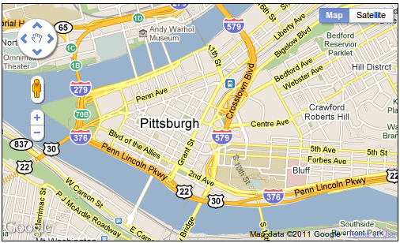
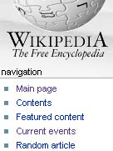
Show me something else
Scroll bars
Panning
Direct-Walk (e.g. hyperlink traversal)
2. Explore

Slide 22
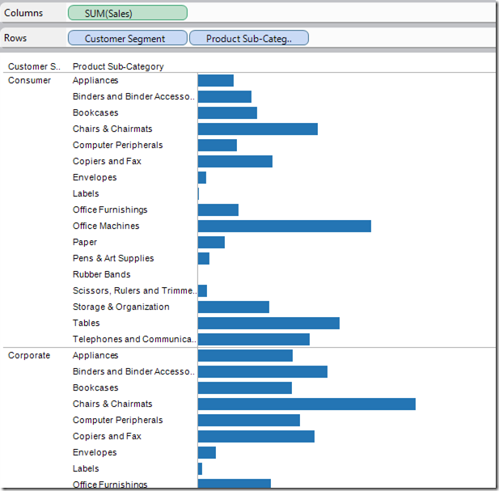
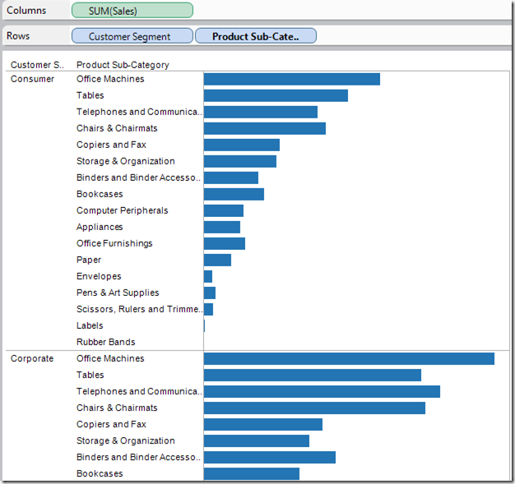
3. Reconfigure
Show me a different arrangement: sorting

Slide 23
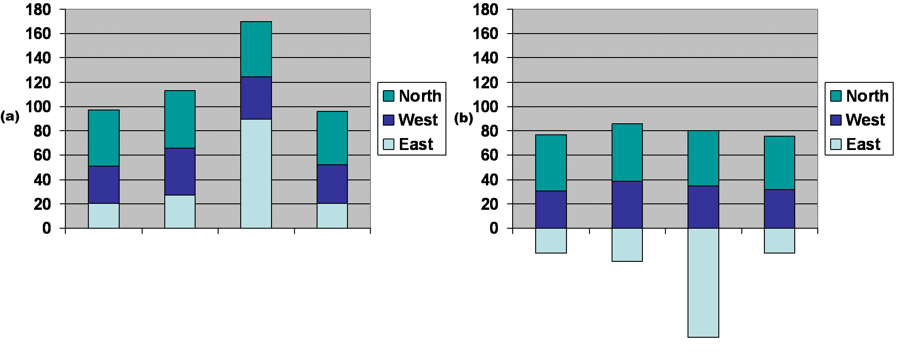
3. Reconfigure
Show me a different arrangement: baseline adjustment

Slide 24
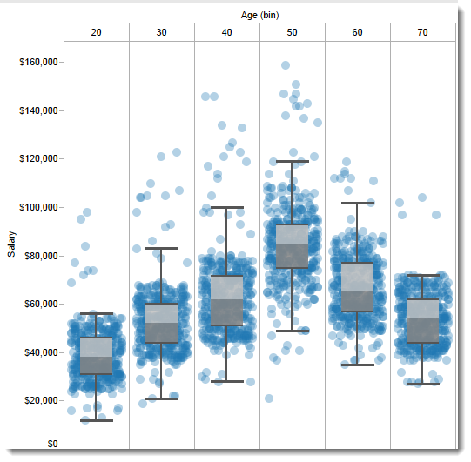
Show me a different arrangement: reduce occlusion (jitter)
3. Reconfigure

Slide 25
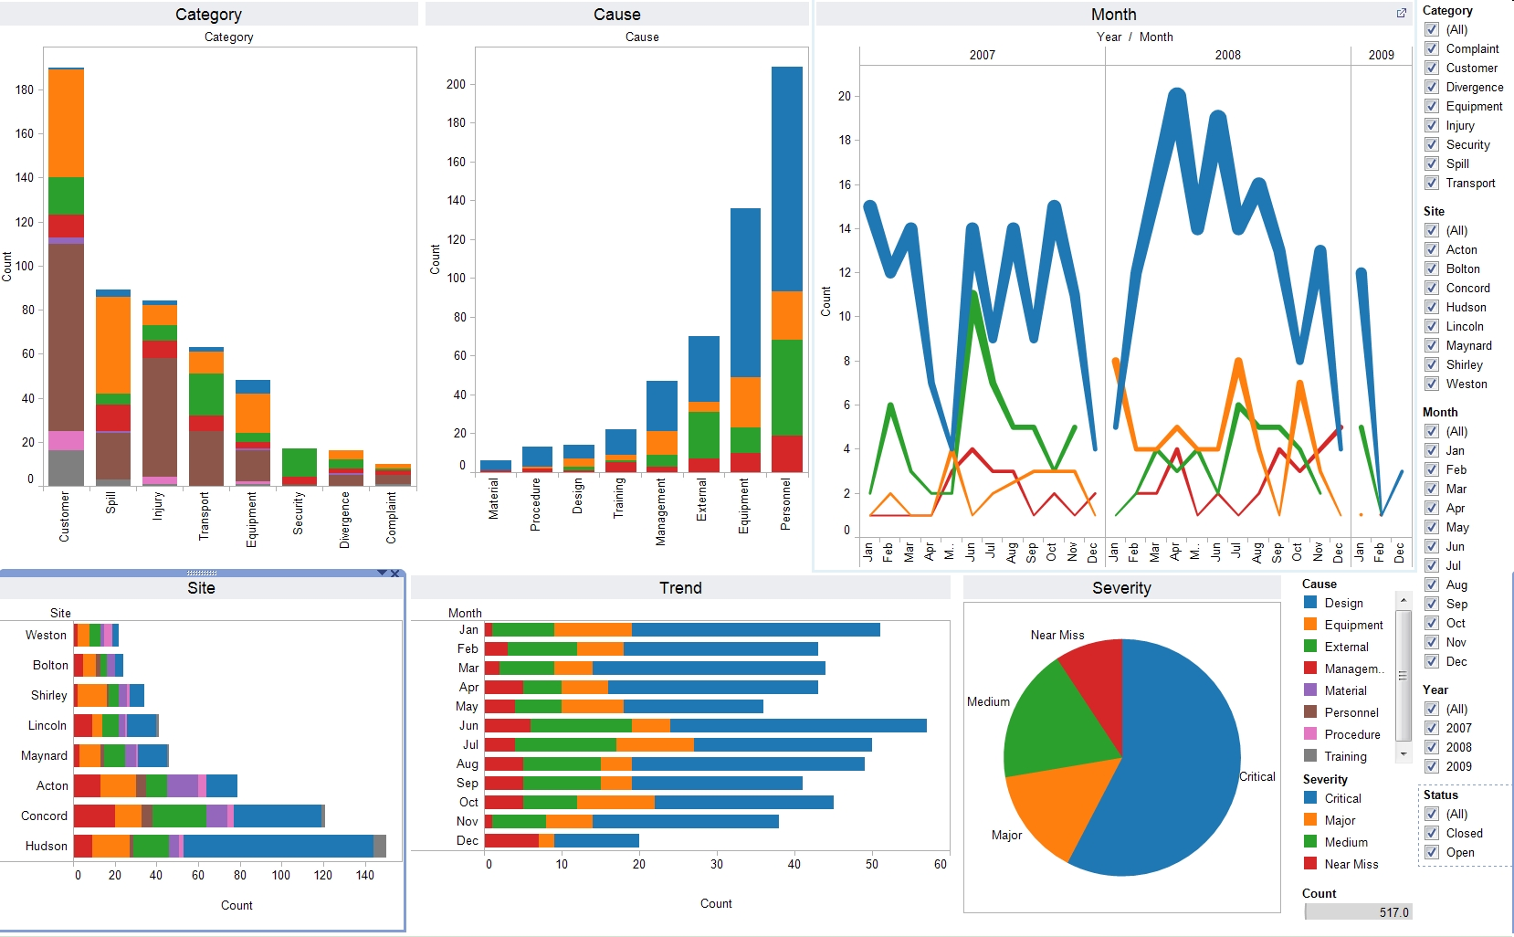
4. Encode
Show me a different representation: visualization type, color, size, orientation, etc.

Slide 26
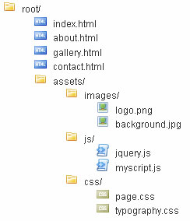
5. Abstract / Elaborate
Show me more or less detail: drill up/down

Slide 27
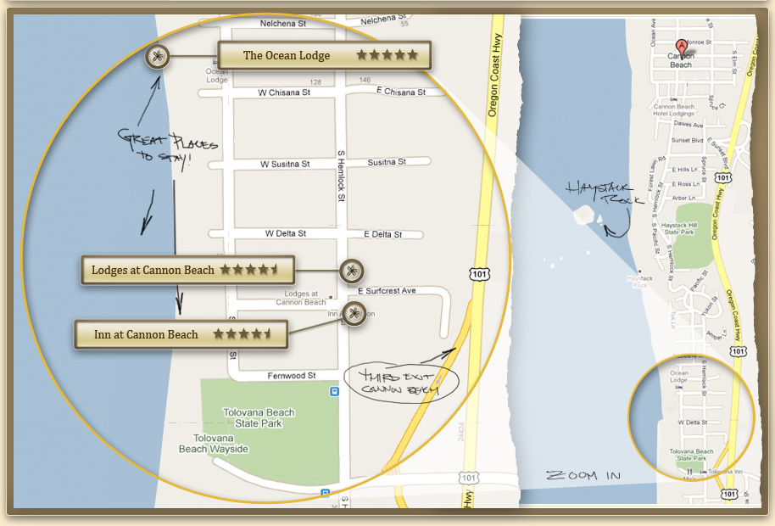
5. Abstract / Elaborate
Show me more or less detail: zooming

Slide 28
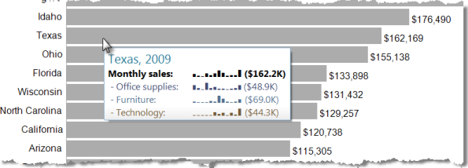
5. Abstract / Elaborate
Show me more or less detail: tooltips

Slide 29
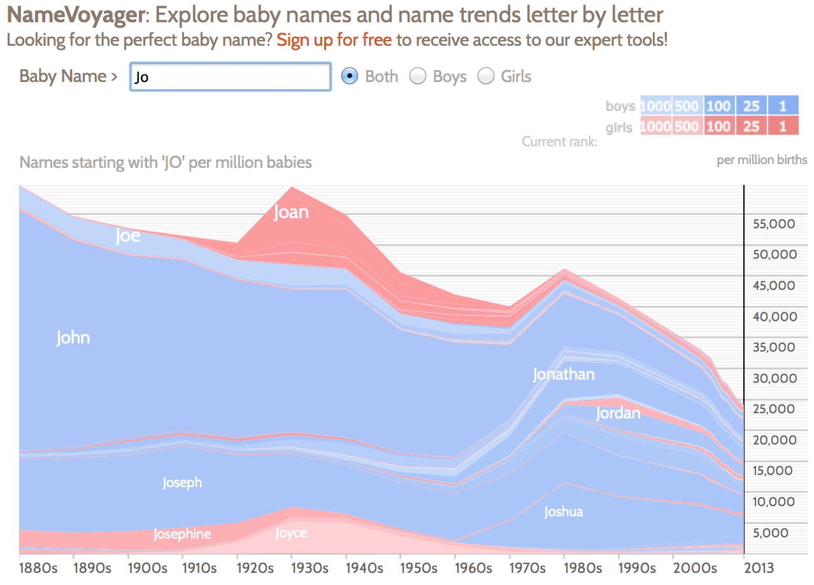
Show me something conditionally
6. Filter

Slide 30
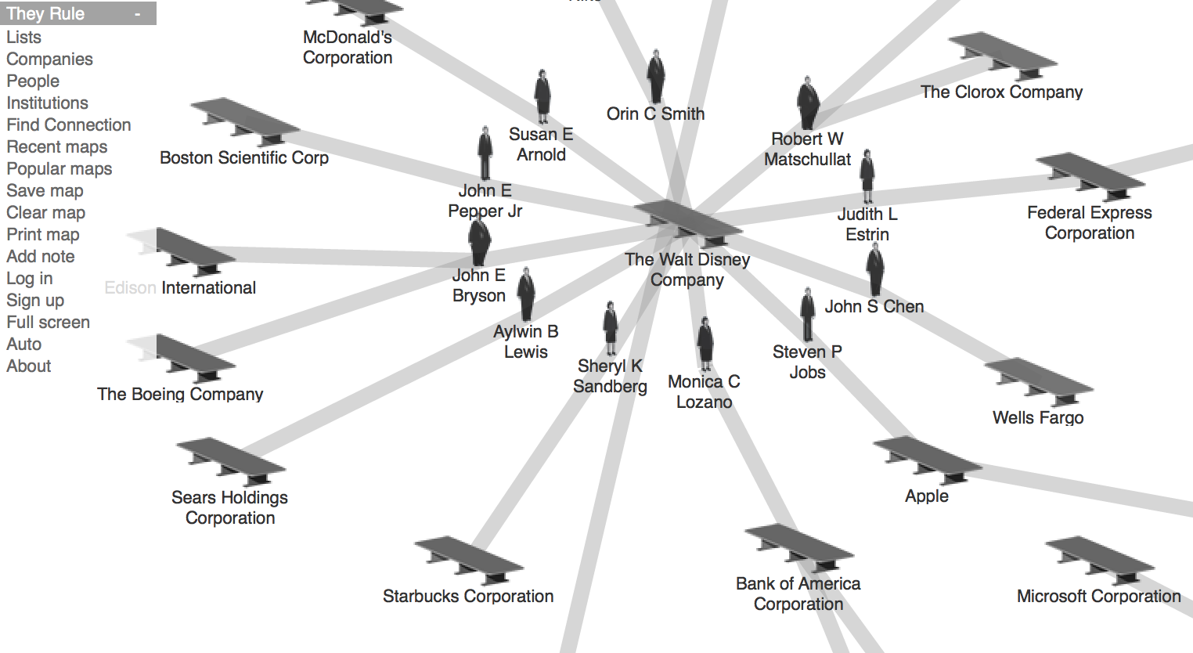
7. Connect
Show me related items: build-out

Slide 31
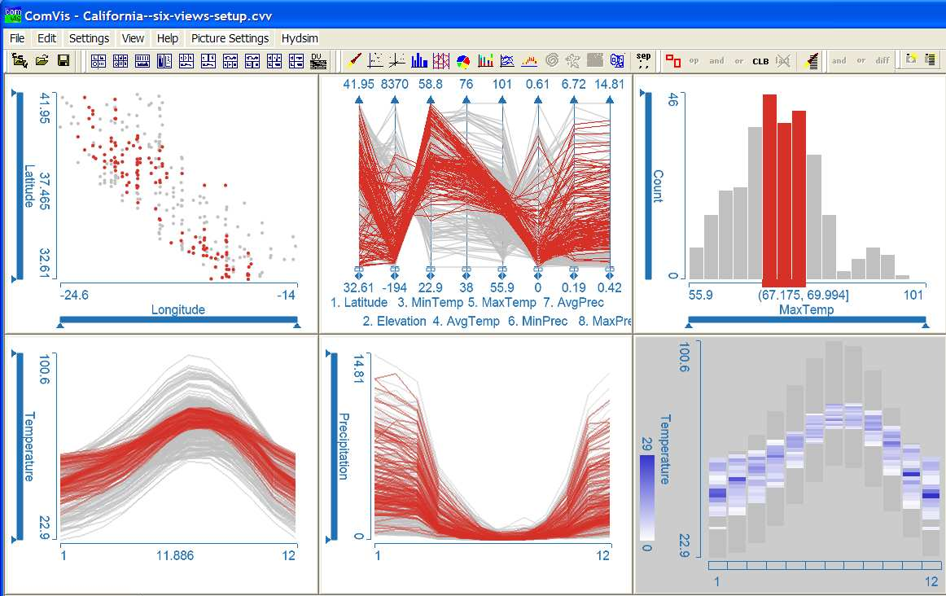
Show me related items: coordinated multiple views (CMV)
7. Connect

Slide 32
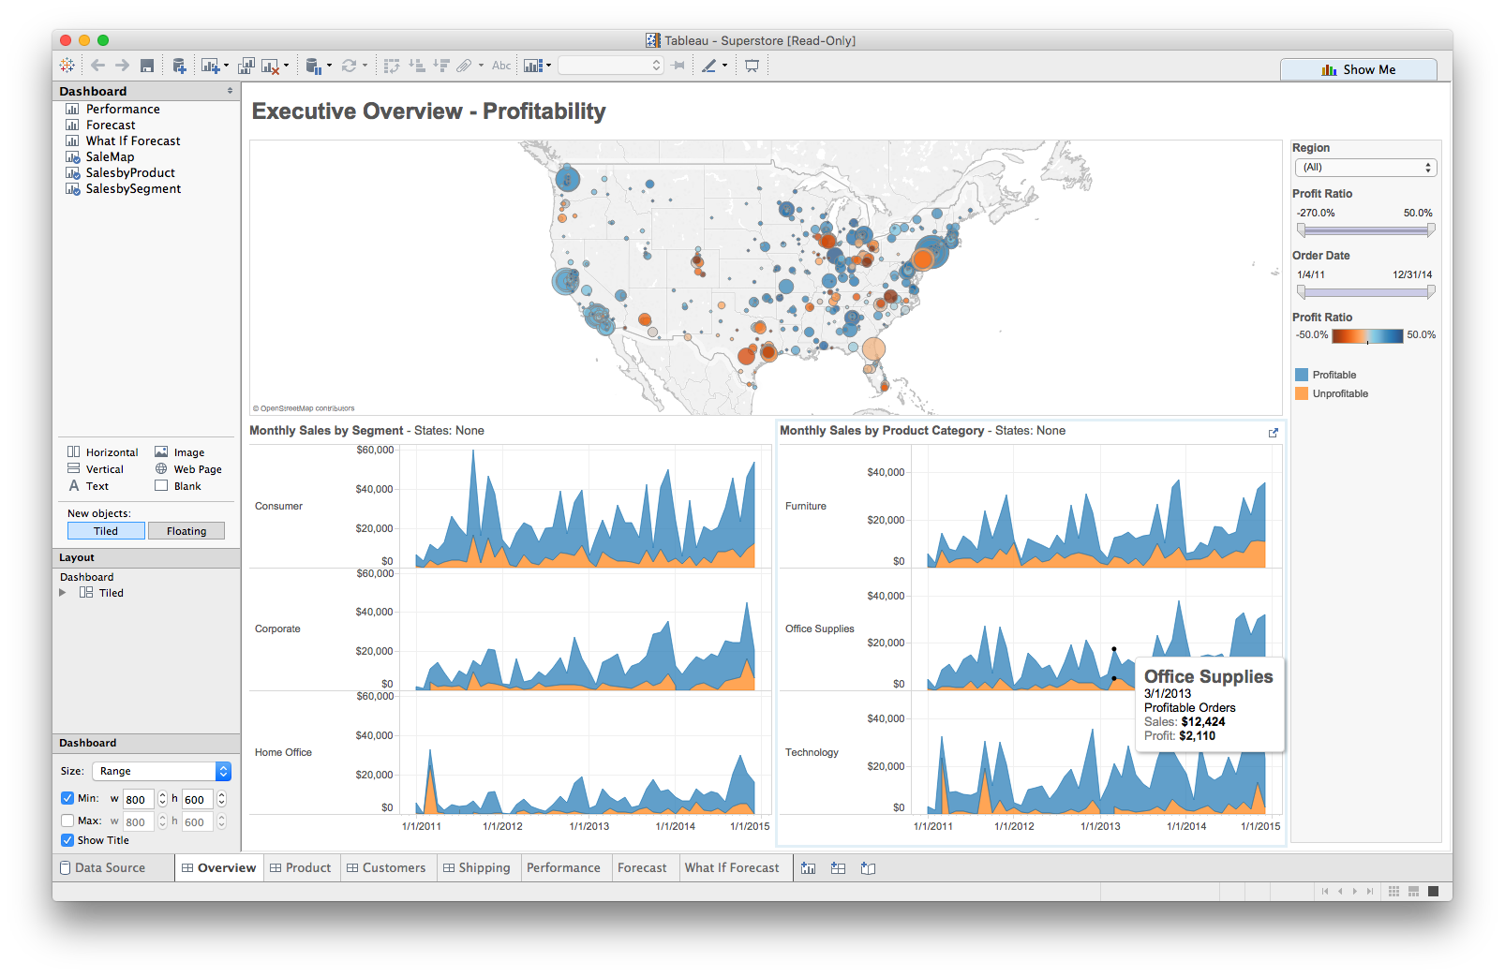
Foreshadowing: Multiple views
Different
representations
Different
data
Systems that use two or more distinct views
to support the exploration of a single concept or domain

Slide 33
Discussion
What would we need to make this work?

Slide 34
Suggested questions to ask when designing
What is the goal of the analysis?
Decision-making
Better understand a domain or a problem
Identify the trends of a phenomenon
Forecast the future
…etc.
What kinds of operations do we need to enable?
How can the visualization support those operations?

Slide 35
Find instructions for today’s lab on the course website
Lab: plotly

